Slide 1

Team1
Sprint1 Overview

Slide 2
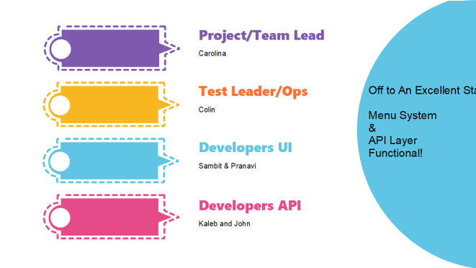

Slide 3
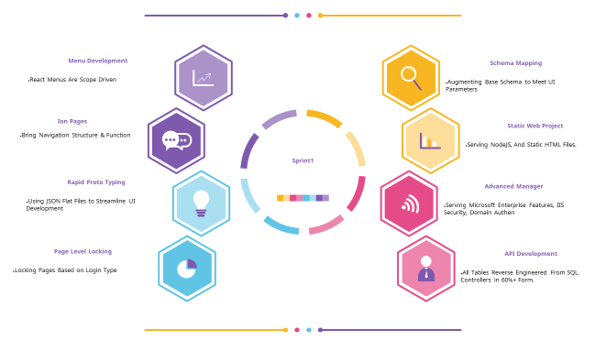

Slide 4
Team Construction
This is a Big Factory Effort
About as Complicated as LinkedIn
At Completion

Slide 5
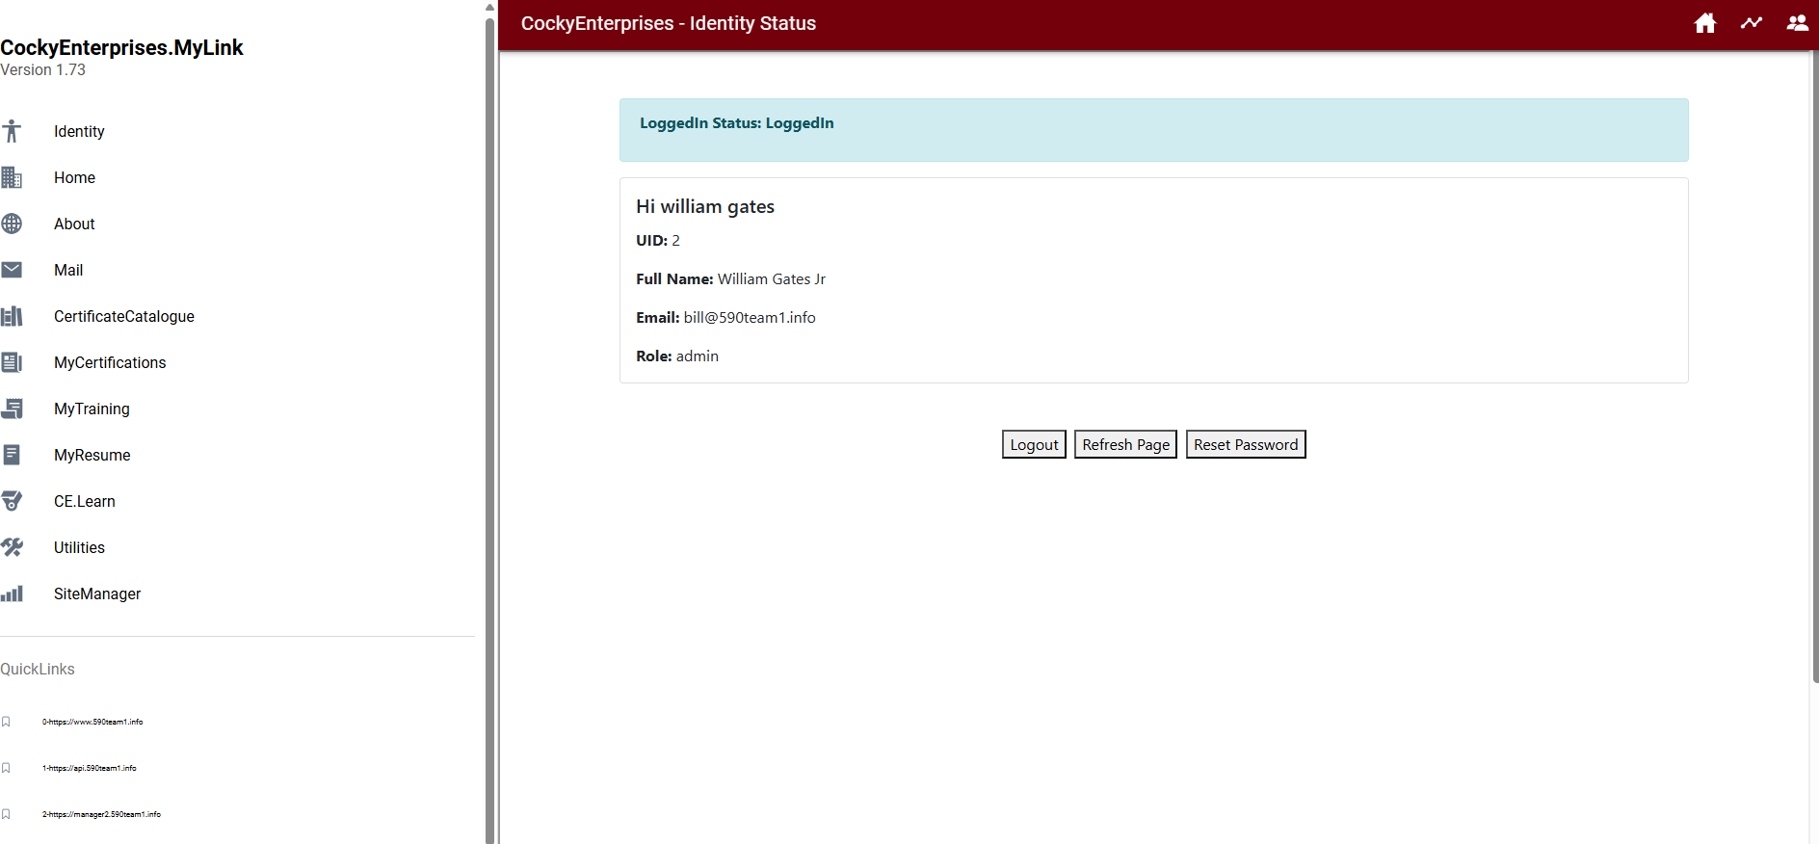
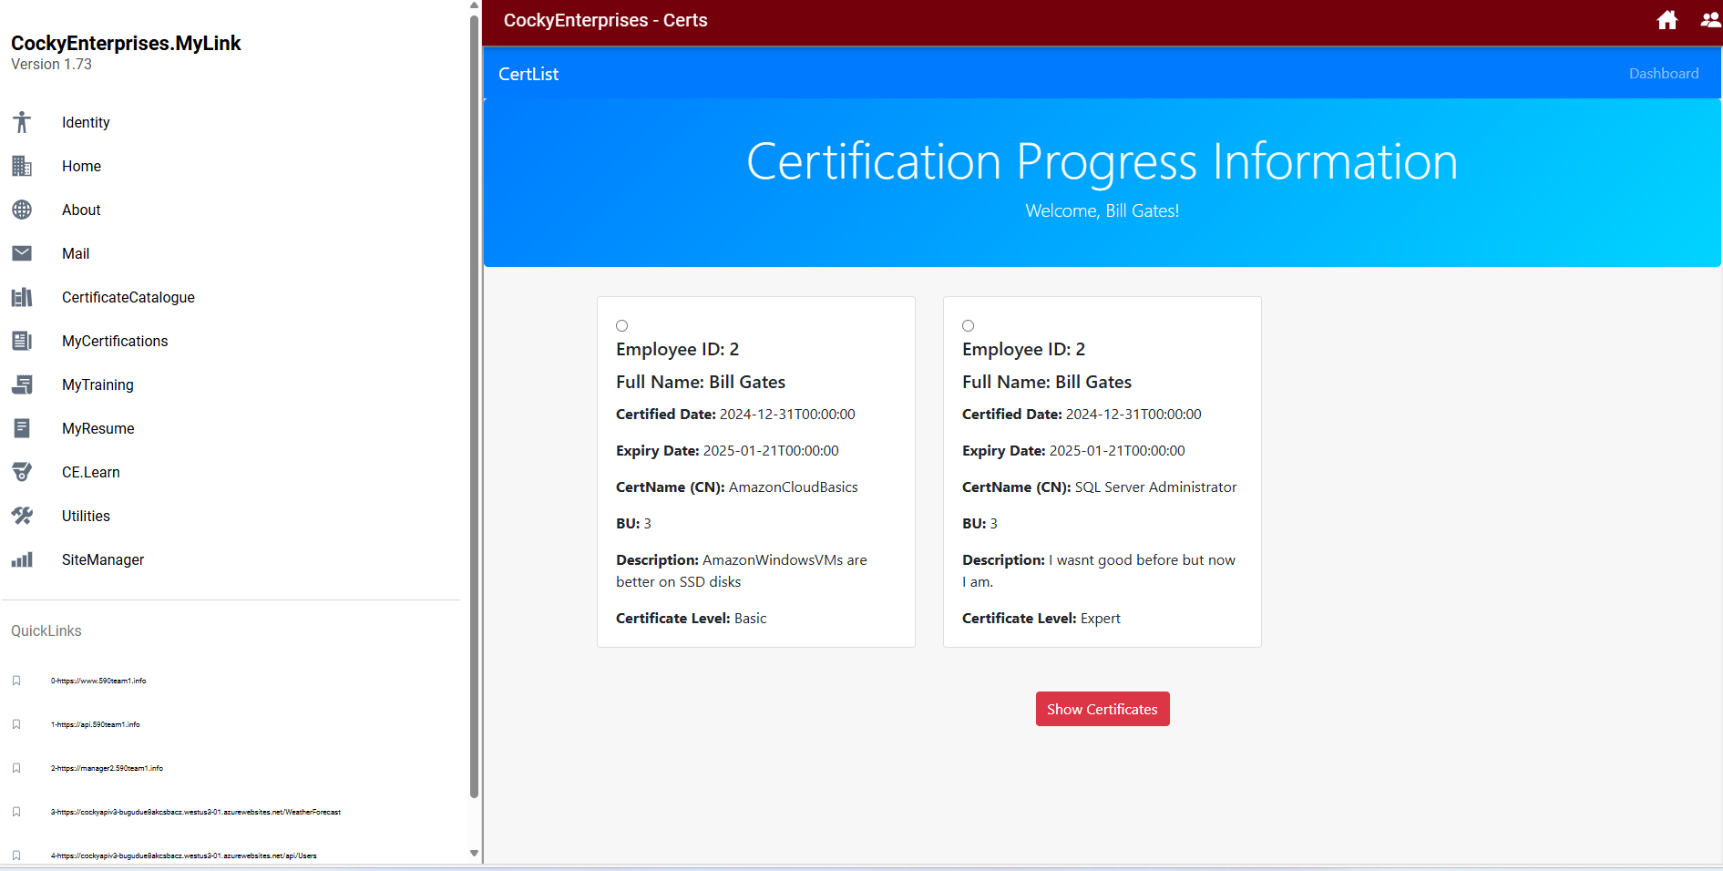
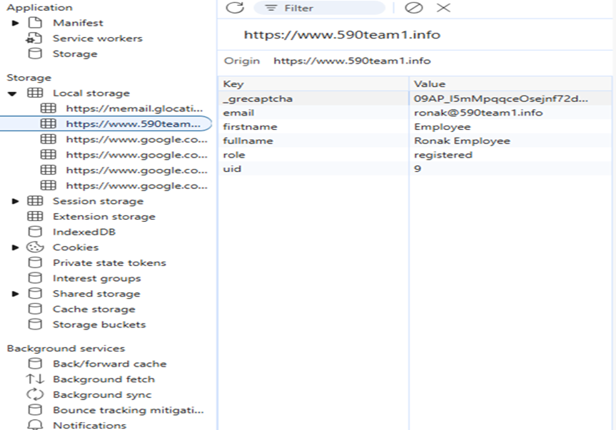
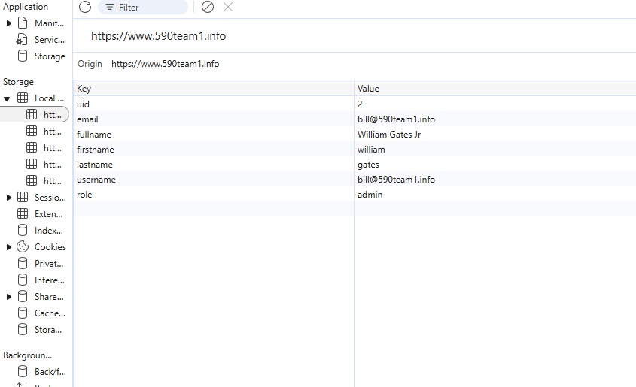
Front to Back

Slide 6
Focus Areas
1
Login
Profile-Setting
2
3
Certificates
Back-Office Progress
4
5
Project Administration

Slide 7
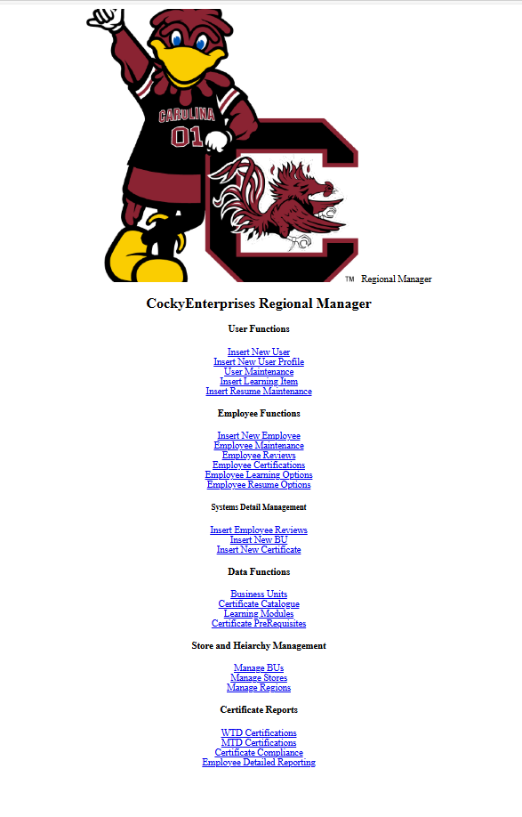
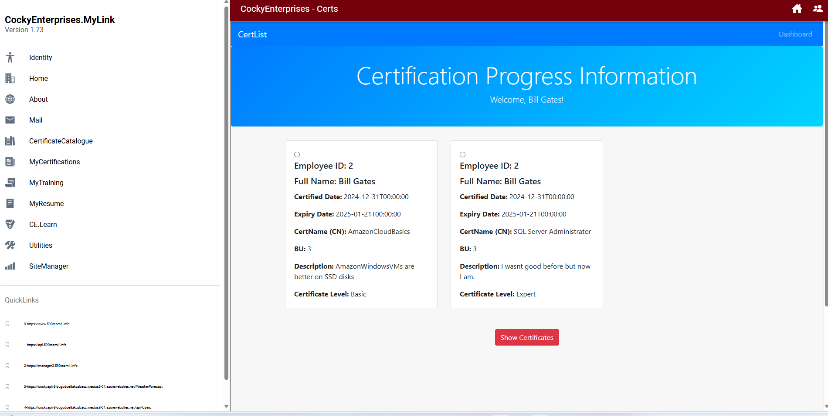
App is Fairly Big Collection Work(30 + 20 + 18)
Approximately 15-20 Screens In UI App
On the Order of 50 Screens Total + 18 APIS ~ 68 Man Weeks
25 Full Screens To Completion + ~5 In Progress

Slide 8
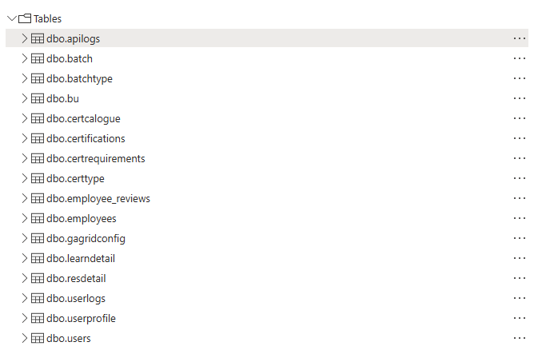



Schema V3 – CE (Cocky Enterprises) – By Area
Our System Makes Use of Users as the Top Level. These are Folks Using Our Platform. They are intended to be employees in the model proposed by the Stakeholders, but don’t have to be in our model. Our Model could support Certifications on Public Internet Users as Well. Like if we wanted to sell training to third parties. Thus user starts our train.
Ops Functions
SSO/System-Functions
User Functions
Ops Functions
Manager/Enterprise Functions

Slide 9
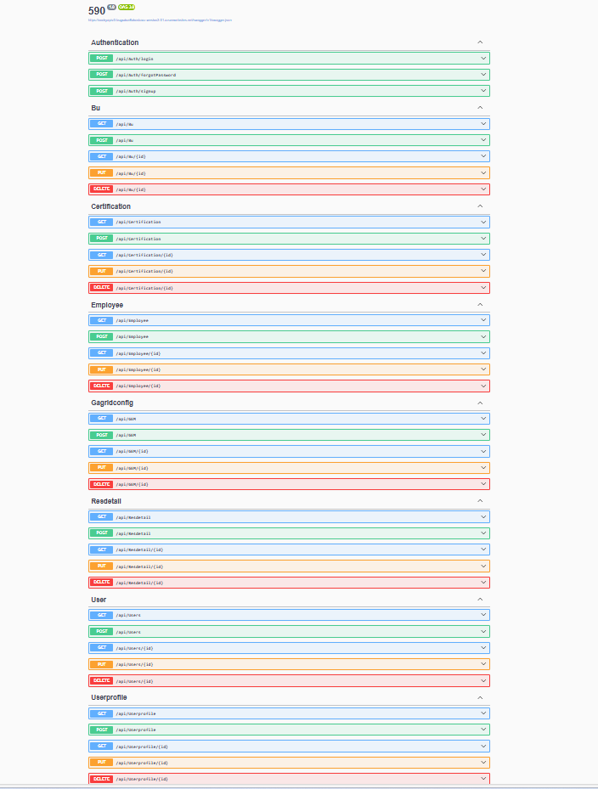
Schema V3 – To Swagger API (IE Controllers)
SSO/System-Functions
User Functions
Auth Controller is SSO Related….
Ops Functions
Manager/Enterprise Functions
7/16 Controllers
Built10 Target
+1 Test(Weather)
+1 Auth(Passwd)
9/18 Complete 50% In Final Form
Sprint0->4 Tables Now 16 Tables->Sprint1

Slide 10
Decisions on V3 Schema
GENERAL RULES OF THE ROAD: 1 CONTROLLER PER TABLE + 2
API for Each Table… Some Not Used by the UI, but are generally useful for System Confidence.
1 API for Weather which always works regardless of DBMS State which is important for UI Self-Automation
1 API For Auth which prevents having to send entire password tables across the wire, which no manager would allow in production on the Public Internet anyway….
Employees are an inherited class of User. [User->Employees. User->Administrators.]
Business Units are Owners of Employees [BU->Employees]
Constraints on Training/Certs at the BU Level.
BUs usually are related to Corporations, and Corporate Sites but these things are stored in all CRM tools.
We have the capability to link our SSO to third party systems like Aloha, Microsoft Dynamics, Oracle Apps via extended fields in the user table.

Slide 11
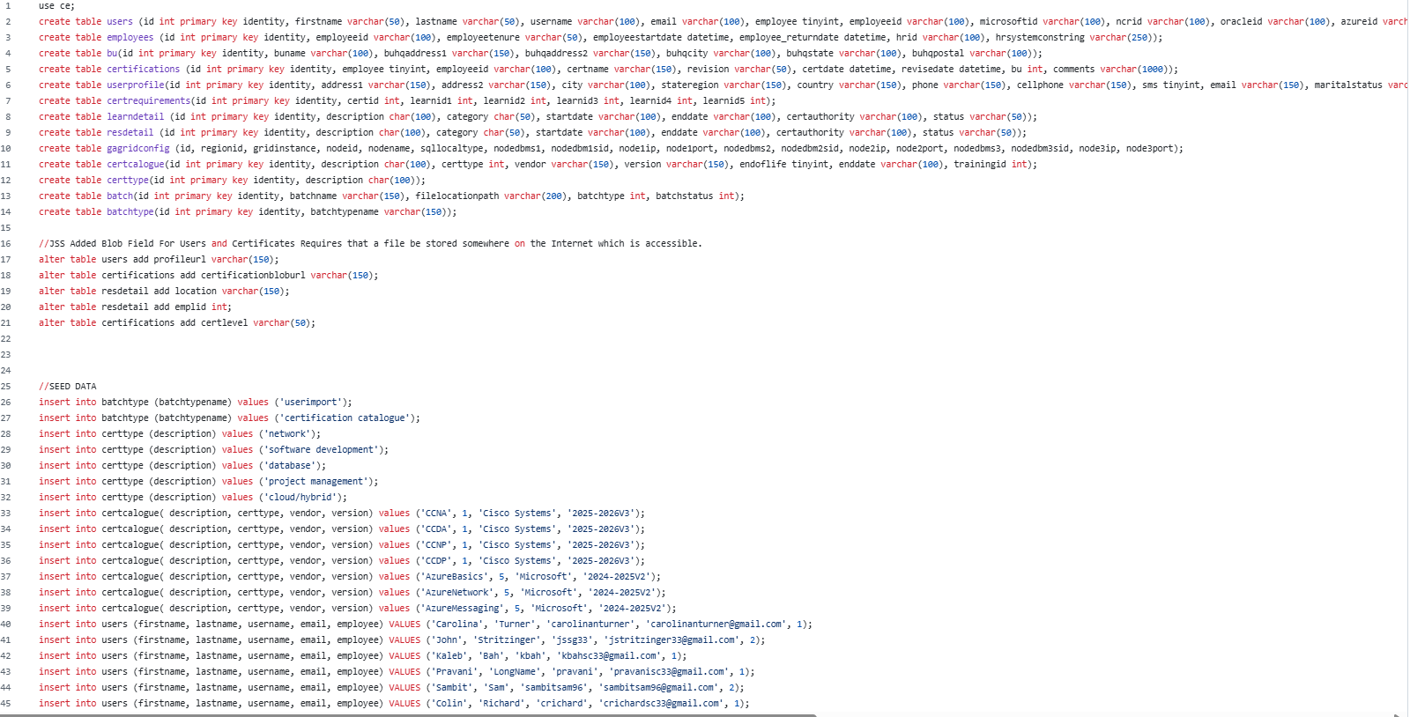
Strawman SQL is Robust…. And growing…

